Slide 1
2 PERMUTATIONS AND COMBINATIONS
Zhou Xiaoyu zhouxy@seu.edu.cn
room 427, Building of School of Computer Science & Engineering

Slide 2
2.1 Four Basic Counting Principles (self study)
Addition Principle.
Suppose that a set S is partitioned into pairwise disjoint parts S₁, S₂ , ... ,S_{m} .
|S| = |S₁| + |S₂| + … + |S_{m}|
exclusive cases that exhaust all possibilities.
Union of sets

Slide 3
Multiplication Principle
Let S be a set of ordered pairs (a, b) of objects, where the first object a comes from a set of size p, and for each choice of object a there are q choices for object b. Then the size of S is p x q:
|S| =|S₁| + |S₂| + ... + |S_{p}l =q + q + … +q (p q's)
= p * q
Cartesian product of sets

Slide 4
Multiplication Principle
If a first task has p outcomes and, no matter what the outcome of the first task, a second task has q outcomes, then the two tasks performed consecutively have p * q outcomes.

Slide 5
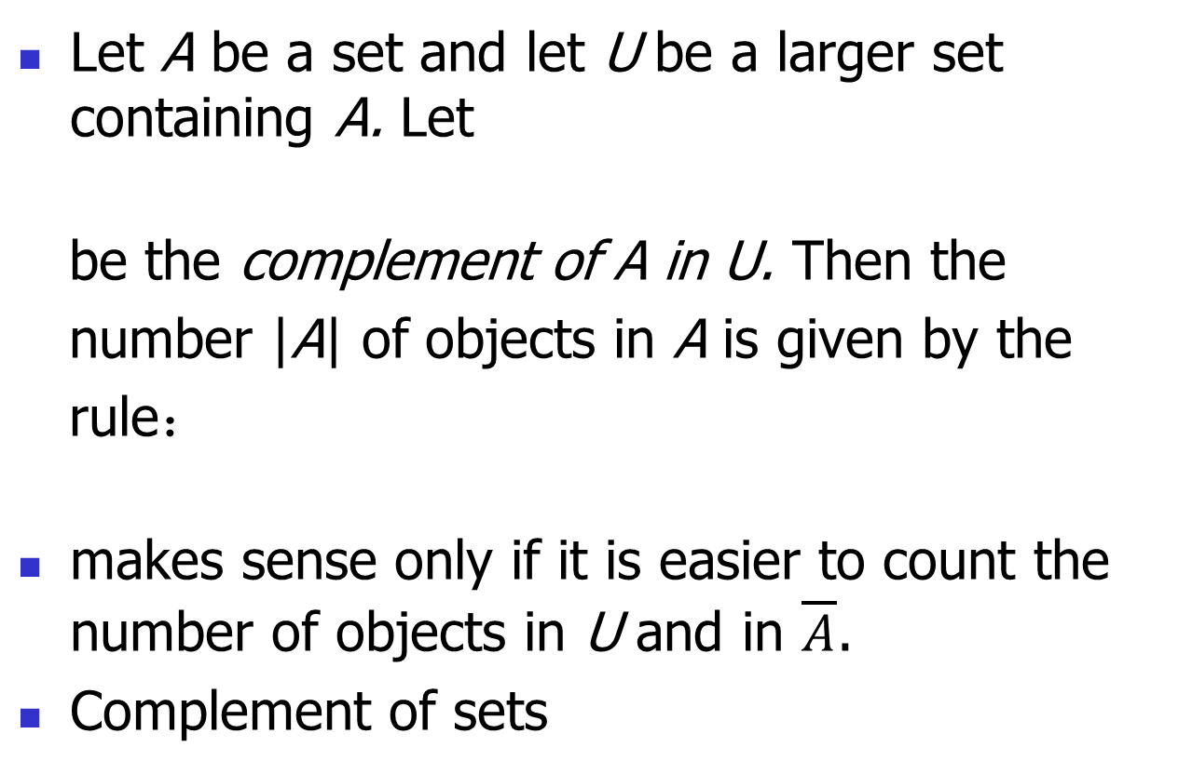
Subtraction Principle
Let A be a set and let U be a larger set containing A. Let
be the complement of A in U. Then the
number |A| of objects in A is given by the
rule：
makes sense only if it is easier to count the number of objects in U and in $\overline{A}\text{.}$
Complement of sets

Slide 6
Example
Computer passwords are to consist of a string of six symbols taken from the digits 0,1,2, ... ,9 and the lowercase letters a, b, c, ... ,z. How many computer passwords have a repeated symbol?

Slide 7
Example
=36⁶-36×35×34×33×32×31
=2,176,782,336 – 1,402,410,240
=774,372,096

Slide 8

Division Principle
Let S be a finite set that is partitioned into k parts in such a way that each part contains the same number of objects. Then the number of parts in the partition is given by the rule:
Quotient set.

Slide 9
2.2 Permutations of Sets
By an r-permutation of a set S of n elements, we understand an ordered arrangement of r of the n elements.

Slide 10
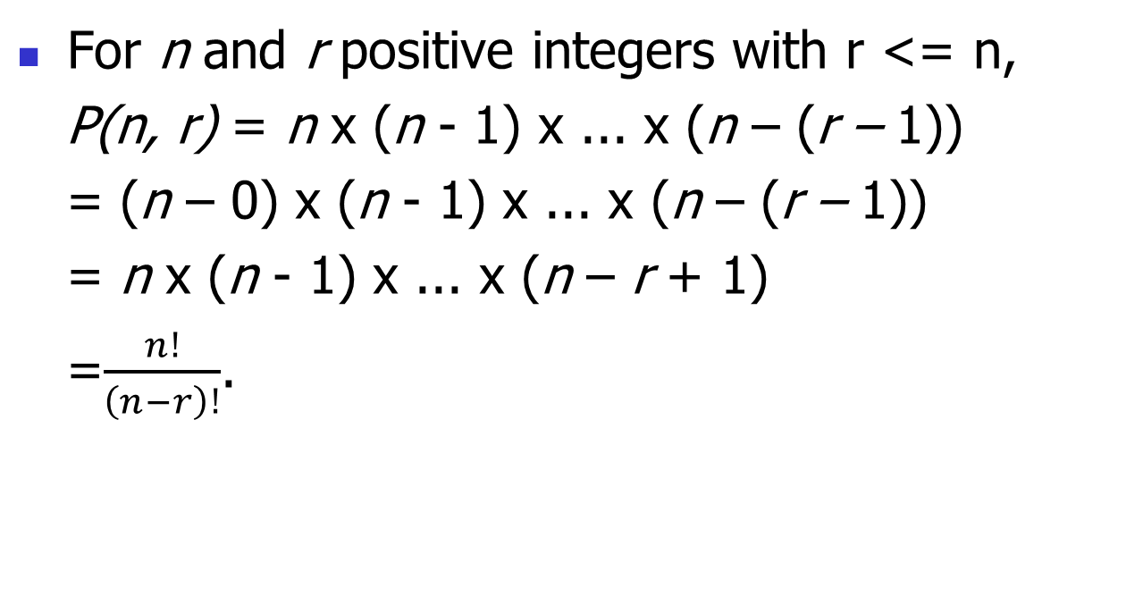
Theorem 2.2.1
For n and r positive integers with r <= n,
P(n, r) = n x (n - 1) x ... x (n – (r – 1))
= (n – 0) x (n - 1) x ... x (n – (r – 1))
= n x (n - 1) x ... x (n – r + 1)
=$\frac{n!}{\left(n−r\right)!}$.

Slide 11

P(n, r)
r = 0: P(n, r) = 1 = $\frac{n!}{\left(n−0\right)!}$
r > n: P(n, r) = 0

Slide 12
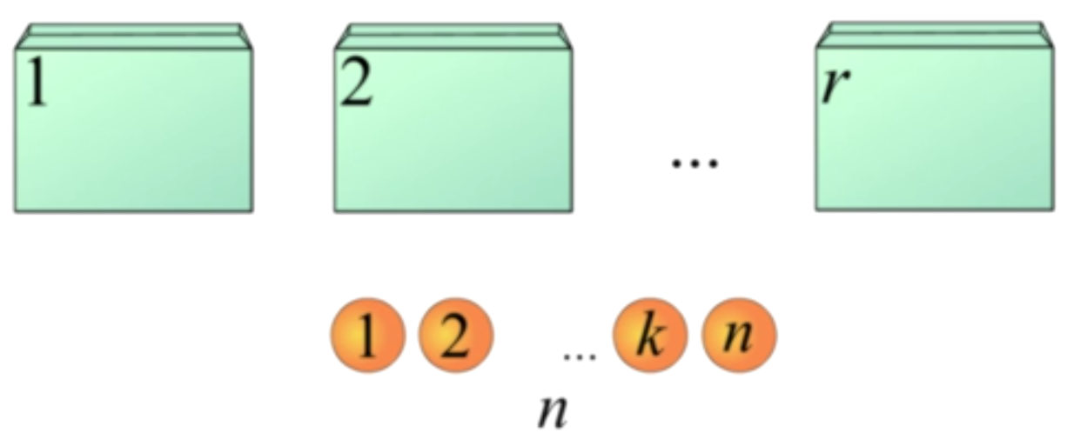
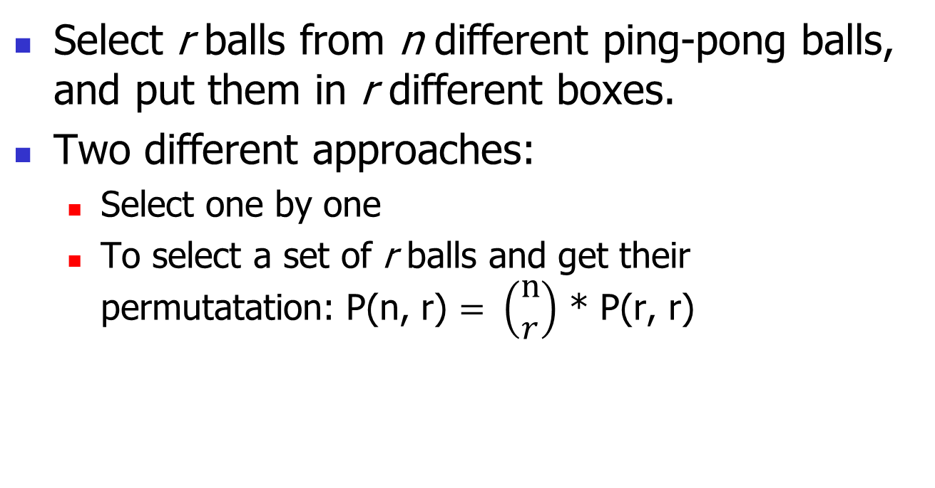
Put Ping-pong Balls in Boxes
Select r balls from n different ping-pong balls, and put them in r different boxes.
Two different approaches:
Select one by one
To select a set of r balls and get their permutatation: P(n, r) $= \left(\begin{matrix}n \\ r\end{matrix}\right)$ * P(r, r)

Slide 13
Permutation as the Number of Functions
F_{inj}(单射): A -> B, |A| = r, |B| = n, injection: for all a₁, a₂, a₁ <> a₂ => f(a₁) <> f(a₂)
P(n, r)
Full function: f: A -> B, |A| = r, |B| = n,
n^{r}

Slide 14
Permutation as the Number of Function
P(n, n)
f: A -> B, |A| = n, |B| = n,
Bijection from A to B
Pairing of n positions and n objects.
Pairing of n objects of type A and n objects of type B.

Slide 15
Example (for self study)
What is the number of ways to order the 26 letters of the alphabet so that no two of the vowels a, e, i, o, and u occur consecutively?

Slide 16
Solution
Construction from the very beginning
Insert consonants into vowels
Easy to begin, but too much variability in progress.

Slide 17
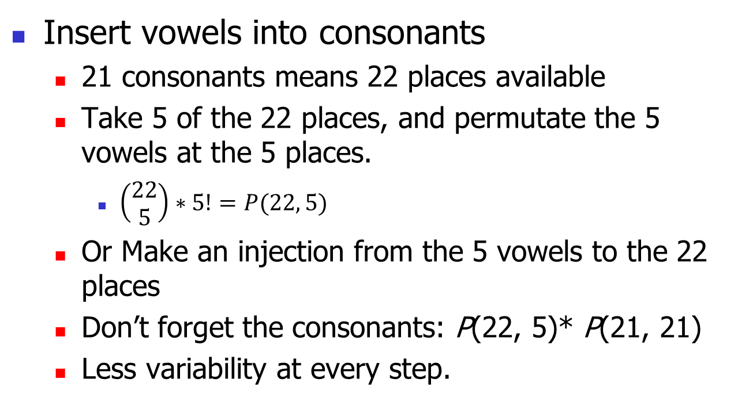
Solution
Insert vowels into consonants
21 consonants means 22 places available
Take 5 of the 22 places, and permutate the 5 vowels at the 5 places.
$\left(\begin{matrix}22 \\ 5\end{matrix}\right)∗5!=P(22, 5)$
Or Make an injection from the 5 vowels to the 22 places
Don’t forget the consonants: P(22, 5)* P(21, 21)
Less variability at every step.

Slide 18
Example (for self study)
How many seven-digit numbers are there such that the digits are distinct integers taken from {1, 2, ... ,9} and such that the digits 5 and 6 do not appear consecutively in either order?
Two trains of thought
Constructive: addition principle and multiplication principle
Exclusive: subtraction principle

Slide 19
Solution 1 (for self study)
(1) neither 5 nor 6 appears as a digit:
7-permutations of {1, 2, 3, 4, 7, 8, 9}: P(7, 7)
(2) 5, but not 6, appears as a digit:
P(8, 7)? no, 5 may not appear
Step 1, select a position for digit 5: C((6 + 1), 1)
Step 2, permutation of the remaining digits: P(7, 6)
(3) 6, but not 5, appears as a digit
C((6 + 1), 1) * P(7, 6)

Slide 20
Solution 1 (for self study)
(4) both 5 and 6 appear as digits.
Permutation of digits other than 5 and 6: P(7, 5)
5 digits that are not equal to 5 or 6 forms 6 partitions, select two partitions for digits 5 and 6: C (6, 2)
Permutation of digits 5 and 6: P(2, 2)
P(7, 5) * C (6, 2) * P(2, 2) = 75600

Slide 21
Solution 2 (for self study)
P(9, 7) minus those with 5 and 6 appear consecutively.
Place the consecutive 5 and 6 (in either order) at the places besides the other 5 digits
Permutation of digits other than 5 and 6: P(7, 5)
5 digits that are not equal to 5 or 6 forms 6 partitions, select 1 partitions for the consecutive 5 and 6: P(6, 1)
Permutation of digits 5 and 6: P(2, 2)
P(9, 7) – P(7, 5) * P(6, 1) * P(2, 2)

Slide 22

Solution 3 (for self study)
Take the consecutive 5 and 6 (in either order) as one special digit, and permutate the 6 ‘digits’
P(9, 7) – $\left(\begin{matrix}7 \\ 5\end{matrix}\right)$ * P(6, 6) * P(2, 2)
Less variability

Slide 23
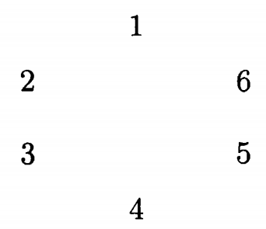
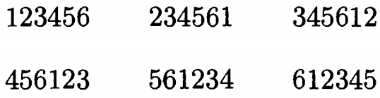

Circular Permutations
Case study.
Expression of circular:
clockwise
To decide the equivalence calss
enumerate the elements of an equivalence class.
P(6, 6) / 6 = P(5, 5)

Slide 24
Circular Permutations
What’s the difference between the elements of an equivalence class:
the head:
it doesn’t matter => choose arbitrary one as the head and make linear permutation of the others.
P(5, 5) = P(6, 6) / 6
Two different combinatorial interpretations.

Slide 25
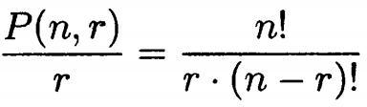
Theorem 2.2.2
The number of circular r-permutations of a set of n elements is
In particular, the number of circular permutations of n elements is (n - 1)!

Slide 26
Example
Ten people, including two who do not wish to sit next to one another, are to be seated at a round table. How many circular seating arrangements are there?
9! - 2 x 8! = 7 x 8！
9!: circular permutation of 10 people.
2 x 8!: circular permutation of 10 people with the two persons sitting next to each other.

Slide 27
Example
Another method：constructive thinking
Let the 10 people be P₁ , P₂ , P₃ , ... , P₁₀ , where P₁ and P₂ are the two who do not wish to sit together.
Arrange the special persons first: First seat P₁ at the "head“ of the table. Then P₂ cannot be on either side of P_{1.}
7 choices for P2, then linear permutation for the remaining 8 persons: 7 * 8!
There are 8 choices for the person on P₁'s left, 7 choices for the person on P₁'s right, and the remaining seats can be filled in 7! ways: 8 x 7 x 7! = 7 x 8！

Slide 28
2.3 Combinations (Subsets) of Sets (SELF STUDY)

Slide 29
Combination
Let S be a set of n elements. A combination of a set S is a term usually used to denote an unordered selection of the elements of S.
the terms combination and subset are essentially interchangeable.

Slide 30
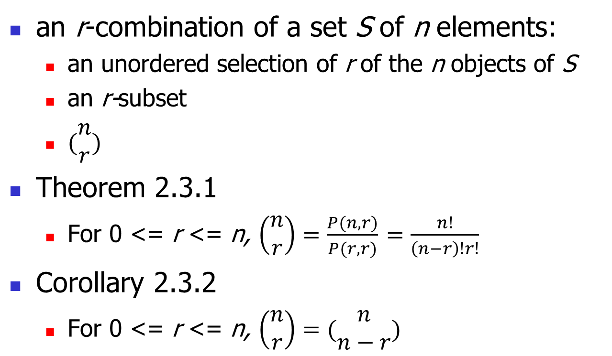
r-combination of S
an r-combination of a set S of n elements:
an unordered selection of r of the n objects of S
an r-subset
$(\begin{matrix}n \\ r\end{matrix})$
Theorem 2.3.1
For 0 <= r <= n, $\left(\begin{matrix}n \\ r\end{matrix}\right)=\frac{P(n, r)}{P(r, r)}$ $=\frac{n!}{\left(n−r\right)!r!}$
Corollary 2.3.2
For 0 <= r <= n, $\left(\begin{matrix}n \\ r\end{matrix}\right)=(\begin{matrix}n \\ n−r\end{matrix})$

Slide 31
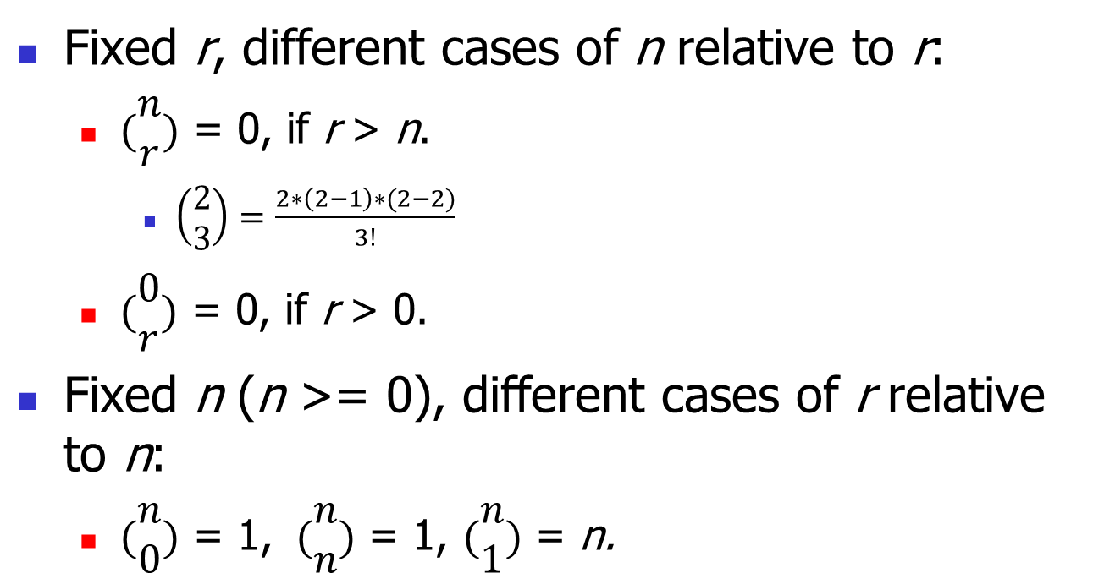
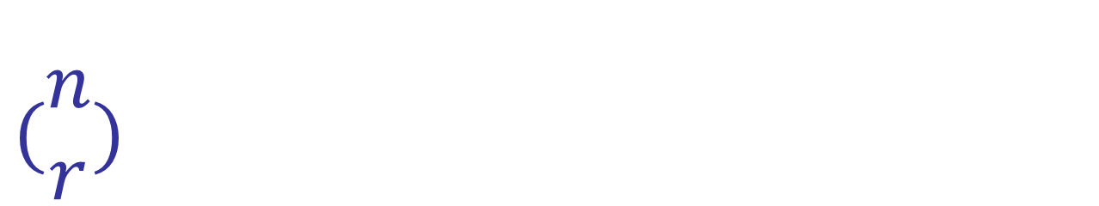
$$(\begin{matrix}n \\ r\end{matrix})$$
Fixed r, different cases of n relative to r:
$(\begin{matrix}n \\ r\end{matrix})$ = 0, if r > n.
$\left(\begin{matrix}2 \\ 3\end{matrix}\right)=\frac{2∗\left(2−1\right)∗(2−2)}{3!}$
$(\begin{matrix}0 \\ r\end{matrix})$ = 0, if r > 0.
Fixed n (n >= 0), different cases of r relative to n:
$(\begin{matrix}n \\ 0\end{matrix})$ = 1, $(\begin{matrix}n \\ n\end{matrix})$ = 1, $(\begin{matrix}n \\ 1\end{matrix})$ = n.

Slide 32
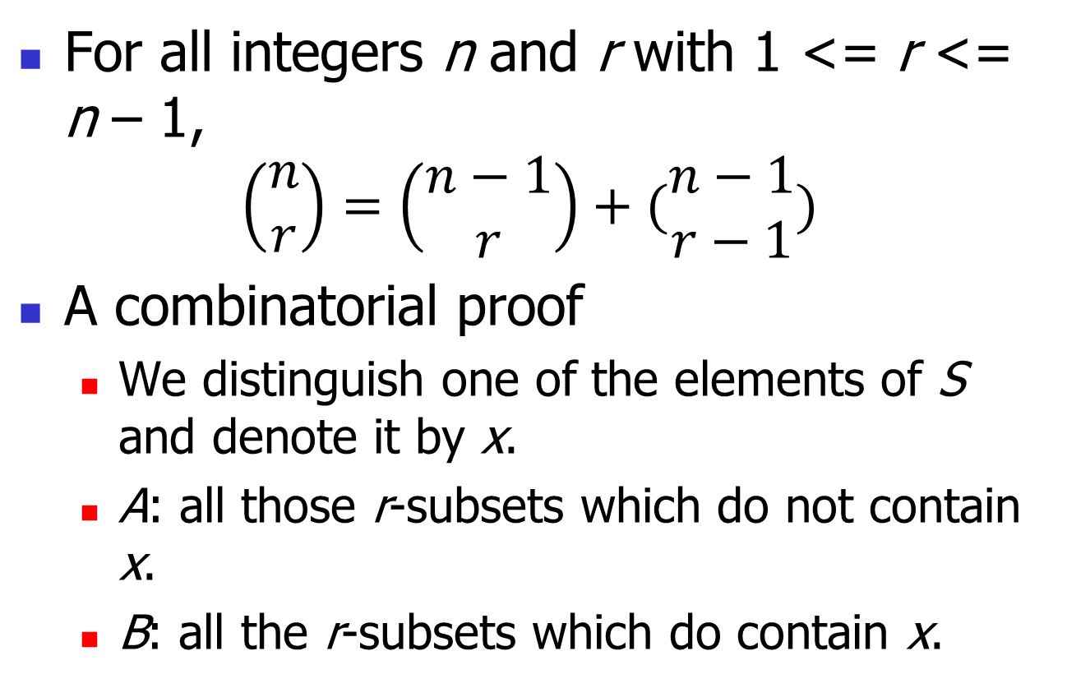
Theorem 2.3.3 (Pascal's formula)
For all integers n and r with 1 <= r <= n – 1,
$$\left(\begin{matrix}n \\ r\end{matrix}\right)=\left(\begin{matrix}n−1 \\ r\end{matrix}\right)+(\begin{matrix}n−1 \\ r−1\end{matrix})$$
A combinatorial proof
We distinguish one of the elements of S and denote it by x.
A: all those r-subsets which do not contain x.
B: all the r-subsets which do contain x.

Slide 33
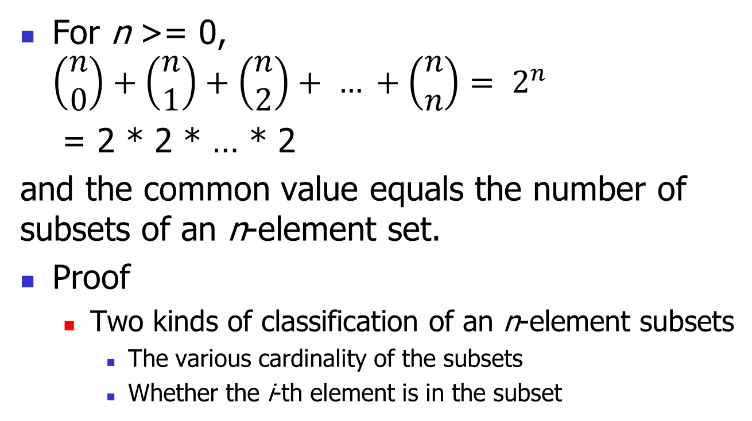
Theorem 2.3.4
For n >= 0, $\left(\begin{matrix}n \\ 0\end{matrix}\right)+\left(\begin{matrix}n \\ 1\end{matrix}\right)+\left(\begin{matrix}n \\ 2\end{matrix}\right)+ … +\left(\begin{matrix}n \\ n\end{matrix}\right)= 2^{n}$
= 2 * 2 * … * 2
and the common value equals the number of subsets of an n-element set.
Proof
Two kinds of classification of an n-element subsets
The various cardinality of the subsets
Whether the i-th element is in the subset

Slide 34
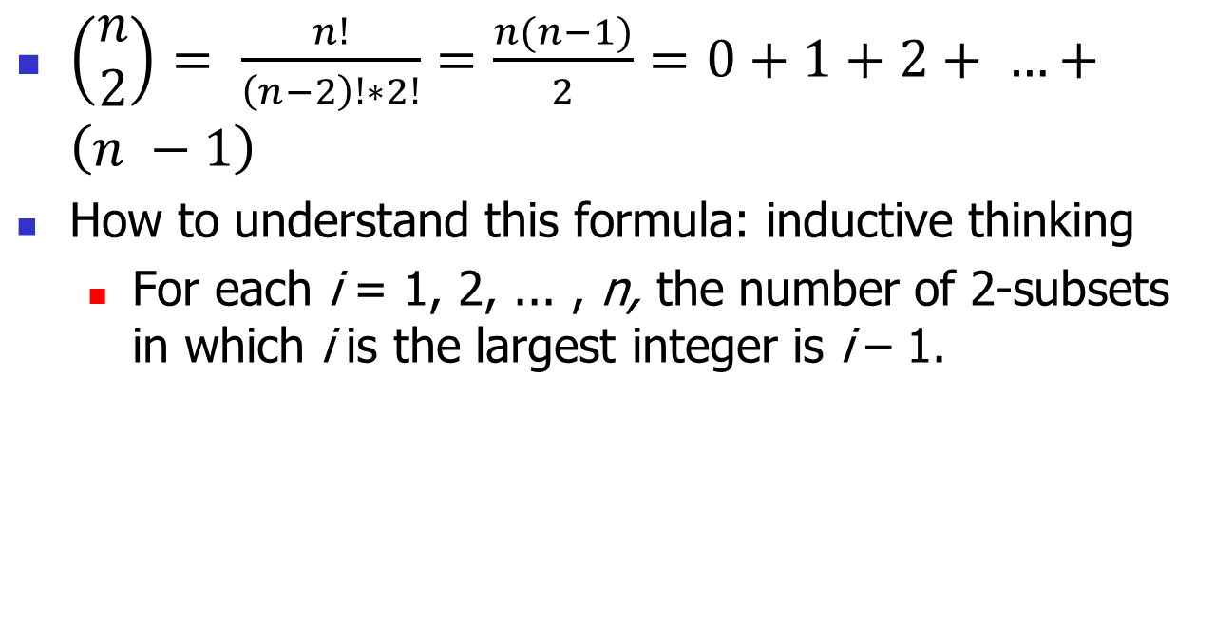
Example
$\left(\begin{matrix}n \\ 2\end{matrix}\right)= \frac{n!}{\left(n−2\right)!∗2!}=\frac{n(n−1)}{2}=0+1+2+ …+\left(n −1\right)$
How to understand this formula: inductive thinking
For each i = 1, 2, ... , n, the number of 2-subsets in which i is the largest integer is i – 1.

Slide 35
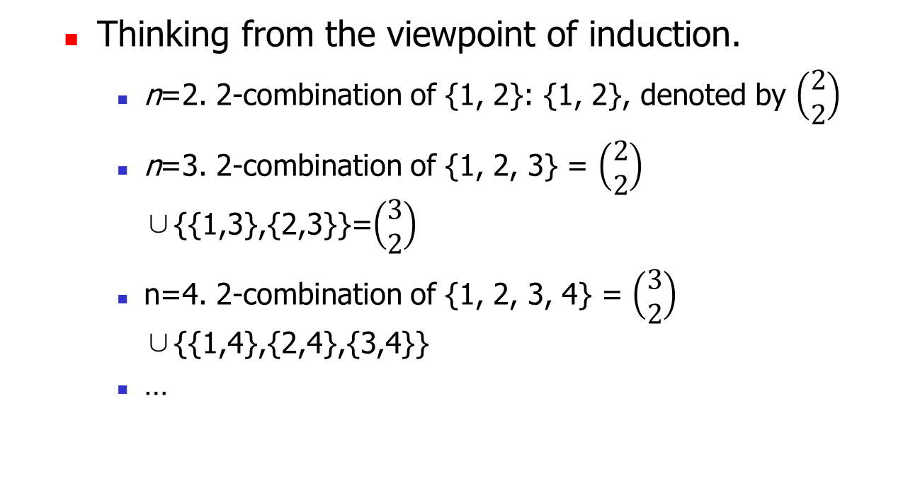
Example
Thinking from the viewpoint of induction.
n=2. 2-combination of {1, 2}: {1, 2}, denoted by $\left(\begin{matrix}2 \\ 2\end{matrix}\right)$
n=3. 2-combination of {1, 2, 3} = $\left(\begin{matrix}2 \\ 2\end{matrix}\right)$ ∪{{1,3},{2,3}}=$\left(\begin{matrix}3 \\ 2\end{matrix}\right)$
n=4. 2-combination of {1, 2, 3, 4} = $\left(\begin{matrix}3 \\ 2\end{matrix}\right)$ ∪{{1,4},{2,4},{3,4}}
…

Slide 36
2.4 Permutations of Multisets

Slide 37
Multiset
Example
S = {2·a, 1·b, 3·c}
A multiset may be formally defined as a 2-tuple (A, m), where A is some set and m is a function from A to the set of positive integers.
A: the underlying set.
M: is the multiplicity function.
number of occurrences of a is: m(a).

Slide 38
Permutations of Multisets
an r-permutation of S
is an ordered arrangement of r of the objects of S.
Example
if S = {2·a, 1·b, 3·c}, then acbc cbcc are 4-permutations of S

Slide 39
Theorem 2.4.1
r-permutations of multiset with only infinite repetition number.
An alternative phrasing:
The number of r-permutations of k distinct objects, each available in unlimited supply.
Let S be a multiset with objects of k different types, where each object has an infinite repetition number. Then the number of r-permutations of S is k^{r}.

Slide 40
Theorem 2.4.1
The conclusion of the theorem remains true if the repetition numbers of the k different types of objects of S are all at Least r.

Slide 41
Theorem 2.4.1
From viewpoint of function
Full function f: A -> B, |A| = r, |B| = k,
k^{r}

Slide 42
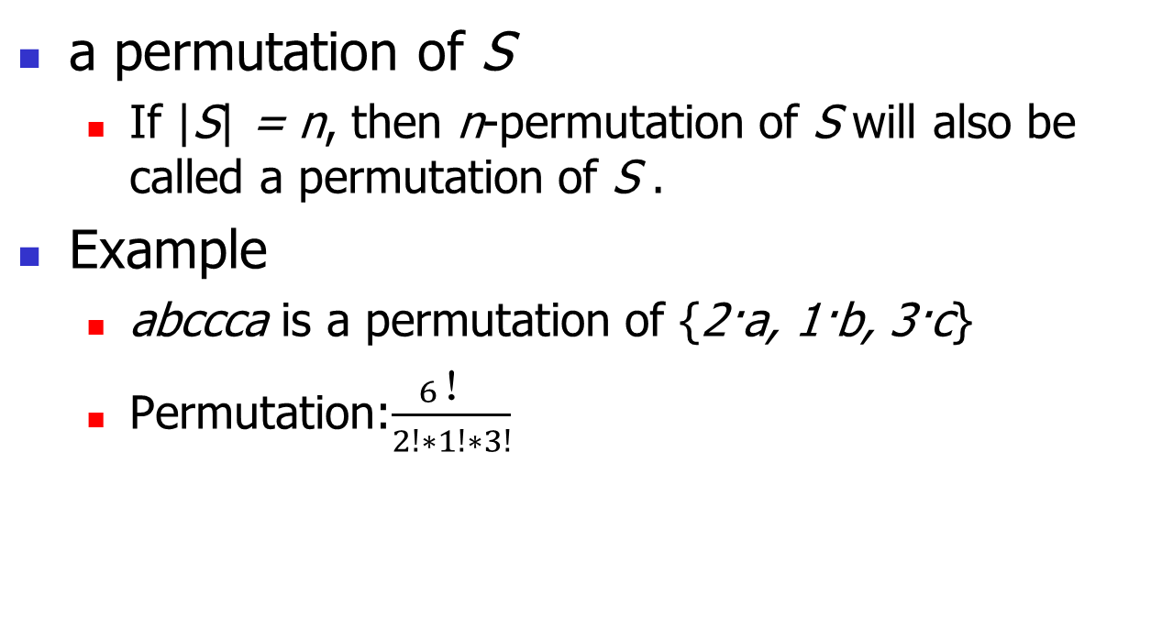
Full Permutations of Multisets
a permutation of S
If |S| = n, then n-permutation of S will also be called a permutation of S .
Example
abccca is a permutation of {2·a, 1·b, 3·c}
Permutation:$\frac{6！}{2!∗1!∗3!}$

Slide 43
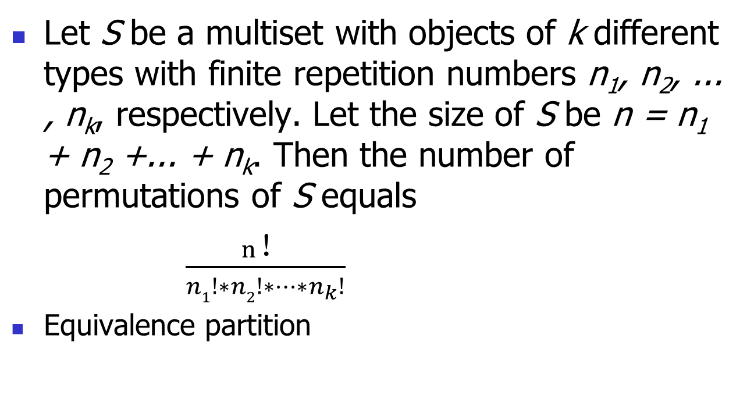
Theorem 2.4.2
Let S be a multiset with objects of k different types with finite repetition numbers n₁, n₂, ... , n_{k}, respectively. Let the size of S be n = n₁ + n₂ +... + n_{k}. Then the number of permutations of S equals
$\frac{n！}{n1!∗n2!∗…∗n_{k}!}$
Equivalence partition

Slide 44
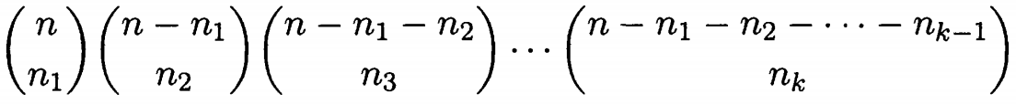
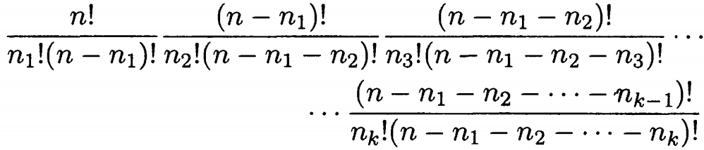
Theorem 2.4.2
Select n_{i} positions for the ith kind of objects:
Combination
Intuitively, Give n movie tickets to the monitor of k classes (n students in total).

Slide 45
Full Permutation of Multisets
If we do not distinguish between the students in the same class, the number of seating students of K classes to watch a movie together is equal to the number of issuing movie tickets to monitors of the K classes.

Slide 46

Theorem 2.4.3(self study)
Let n be a positive integer and let n₁, n₂, ... ,n_{k} be positive integers with n = n₁ + n₂ +... + n_{k}. The number of ways to partition a set of n objects into k labeled boxes in which Box 1 contains n₁ objects, Box 2 contains n₂ objects, ..., Box k contains n_{k} objects equals.

Slide 47
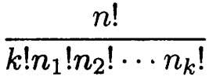
Theorem 2.4.3
If the boxes are not labeled, and n₁ = n₂ = ... = n_{k}, then the number of partitions equals
equivalence class: K- K pairing

Slide 48

Permutation of Multi-set with Only Two Kinds of Objects
two types, a₁ and a₂, of objects with repetition numbers n₁ and n₂, respectively, where n = n₁ + n₂,

Slide 49

Example (for self study)
The number of permutations of the letters in the word MISSISSIPPI is
the number of permutations of the multiset {1·M, 4·1, 4·S, 2·P}.

Slide 50
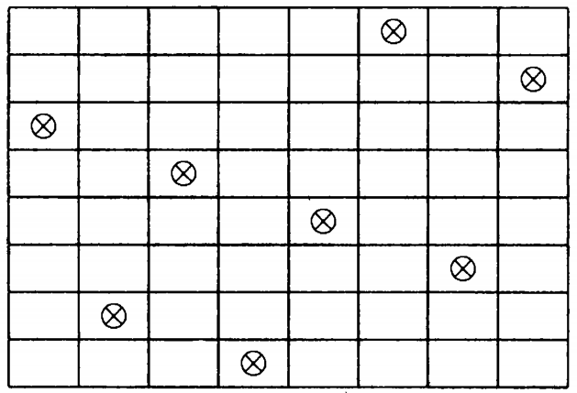
Example: Nonattacking Rooks on a Chessboard(self study)
two rooks can attack one another if and only if they lie in the same row or the same column of the chessboard.
How many possibilities are there for eight nonattacking rooks on an 8-by-8 chessboard?

Slide 51
Nonattacking Rooks on a Chessboard
Assume: the rooks were indistinguishable from one another
Method 1: constructive, Multiplication Principle
Pick one of the 8 rooks as the first one, we have 8 choices of the row number and 8 choices of the column number.
For the second one: 7 and 7 choices
…
8! * 8!
Indistinguishable: 8! *8! / 8! = 8!
Distinguishable: 8! * 8!

Slide 52
Nonattacking Rooks on a Chessboard
Method 2
Analyze the result
the rooks must occupy eight squares with coordinates (1, j₁), (2, j₂), ··· , (8, j₈),
j₁, j₂, ··· , j₈ must be a permutation of {1, 2, ... , 8}.
Thus, we have a one-to-one correspondence between sets of 8 nonattacking rooks on the 8-by-8 board and permutations of {1, 2, ... ,8}: 8!
Implicitly indistinguishable.
Distinguishable: 8! * 8!

Slide 53
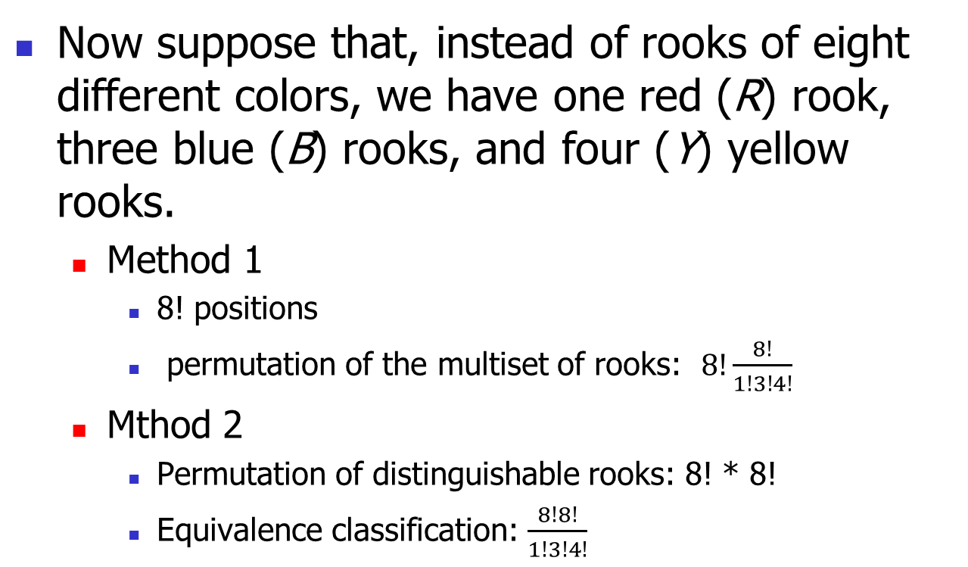
Nonattacking Rooks on a Chessboard
Now suppose that, instead of rooks of eight different colors, we have one red (R) rook, three blue (B) rooks, and four (Y) yellow rooks.
Method 1
8! positions
permutation of the multiset of rooks: $8!\frac{8!}{1!3!4!}$
Mthod 2
Permutation of distinguishable rooks: 8! * 8!
Equivalence classification: $\frac{8!8!}{1!3!4!}$

Slide 54
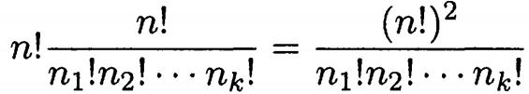
Theorem 2.4.4 (for self study)
There are n rooks of k colors with n₁ rooks of the first color, n₂ rooks of the second color, . . . , and n_{k} rooks of the kth color. The number of ways to arrange these rooks on an n-by-n board so that no rook can attack another equals

Slide 55
Summary
Two Kinds of Permutation of Multisets
r-permutation of multisets with infinite(or plenty of, in other words “>= r”) supply.
Full permutation of multisets with limited supply (in other words, with finite repetition number).

Slide 56
2.5 Combinations of Multisets

Slide 57
r-Combinations of Multisets
If S is a multiset, then an r-combination of S is an unordered selection of r of the objects of S.
r-submultiset.
Equivalence partition of r-permutation?
Example: S = {∞ • a, ∞ • b, ∞ • c}
How many permutations are in the same equivalence class with aabcc: 5!/(2!1!2!)
How many permutations are in the same equivalence class with aaabc: 5!/(3!1!1!)

Slide 58
Theorem 2.5.1
Let S be a multiset with objects of k types, each with an infinite repetition number. Then the number of r-combinations of S equals
?
x₁ + x₂ + … + x_{k} = r
The power of representation: enumerating, naming, and writing them down.

Slide 59
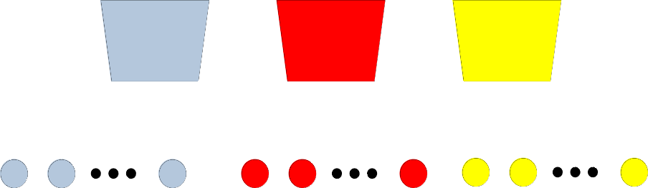
Theorem 2.5.1
How to think?
Imaging that we have got an r-combination.
Listing, illustrating

Slide 60
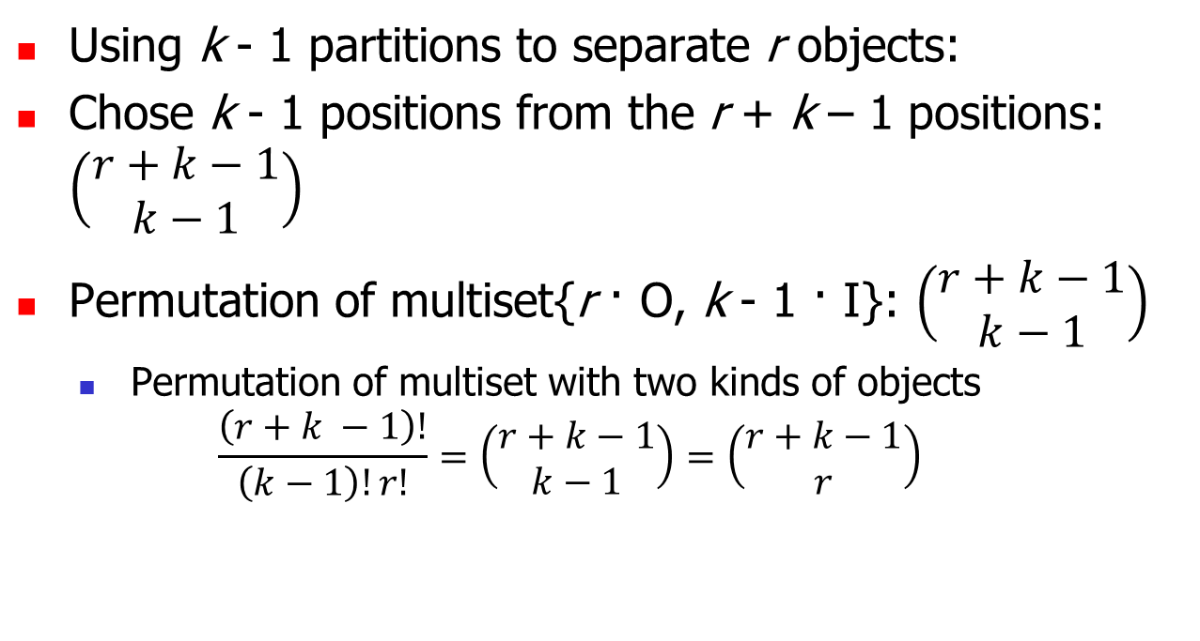
Theorem 2.5.1
Using k - 1 partitions to separate r objects:
Chose k - 1 positions from the r + k – 1 positions: $\left(\begin{matrix}r+k−1 \\ k−1\end{matrix}\right)$
Permutation of multiset{r · O, k - 1 · I}: $\left(\begin{matrix}r+k−1 \\ k−1\end{matrix}\right)$
Permutation of multiset with two kinds of objects
$$\frac{\left(r+k −1\right)!}{\left(k−1\right)!r!}=\left(\begin{matrix}r+k−1 \\ k−1\end{matrix}\right)=\left(\begin{matrix}r+k−1 \\ r\end{matrix}\right)$$

Slide 61
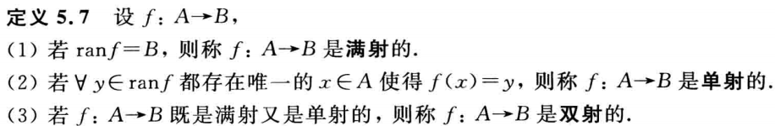
Theorem 2.5.1(extended for self study)
How to prove?
How to prove equation?
Method1
function from permutation to combination: injection (单射)
number of permutation <= number of combination
function from combination to combination: injection
number of combination <= number of permutation
Method2
injection and surjection (满射) <=> bijection (双射)

Slide 62
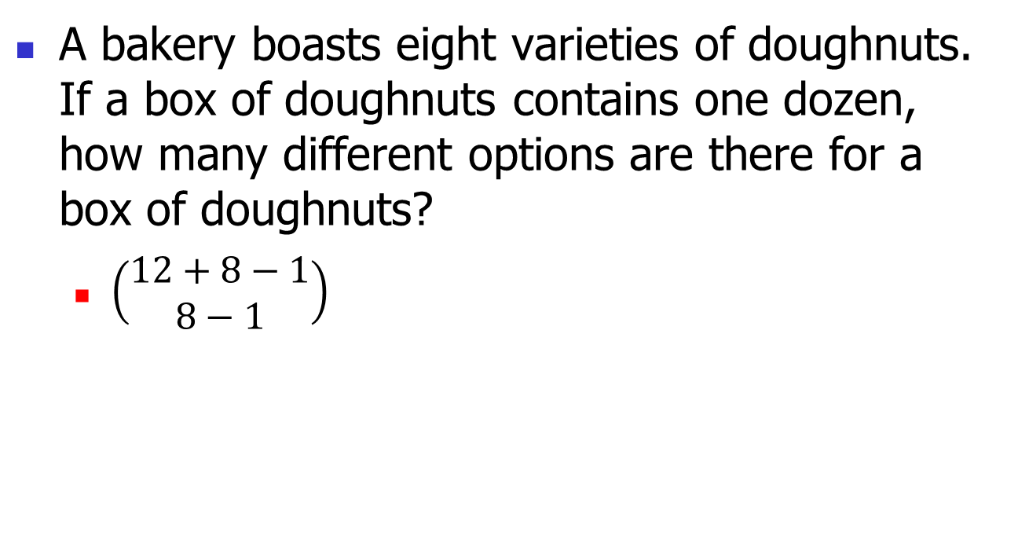
Example
A bakery boasts eight varieties of doughnuts. If a box of doughnuts contains one dozen, how many different options are there for a box of doughnuts?
$\left(\begin{matrix}12+8−1 \\ 8−1\end{matrix}\right)$
Notes:
doughnuts：甜甜圈 boast：骄傲地拥有

Slide 63
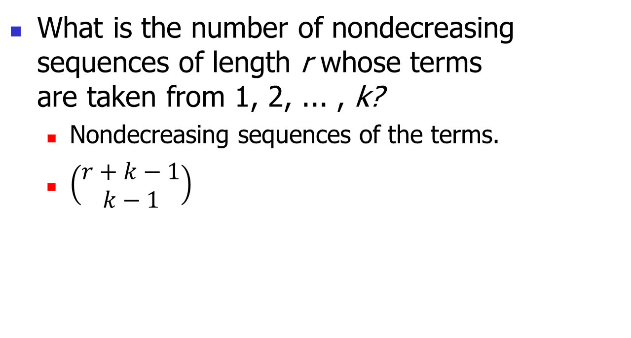
Example
What is the number of nondecreasing sequences of length r whose terms are taken from 1, 2, ... , k?
Nondecreasing sequences of the terms.
$\left(\begin{matrix}r+k−1 \\ k−1\end{matrix}\right)$

Slide 64
Example
Putting restrictions on the number of times each type of object is to occur in the r-combination.

Slide 65
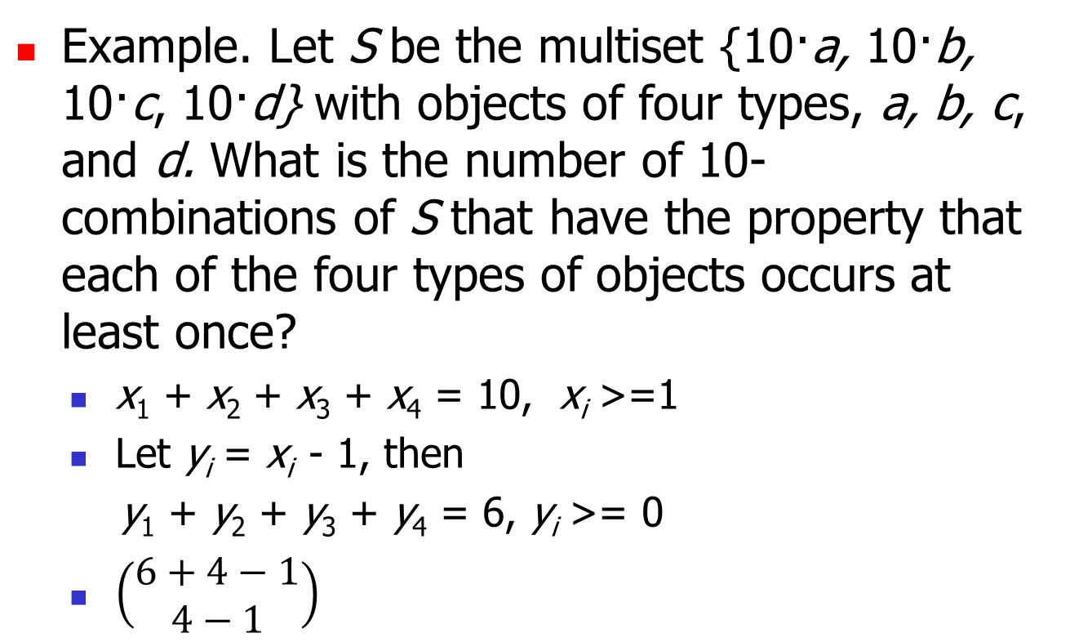
Example
Example. Let S be the multiset {10·a, 10·b, 10·c, 10·d} with objects of four types, a, b, c, and d. What is the number of 10-combinations of S that have the property that each of the four types of objects occurs at least once?
x₁ + x₂ + x₃ + x₄ = 10, x_{i} >=1
Let y_{i} = x_{i} - 1, then
y₁ + y₂ + y₃ + y₄ = 6, y_{i} >= 0
$\left(\begin{matrix}6+4−1 \\ 4−1\end{matrix}\right)$

Slide 66
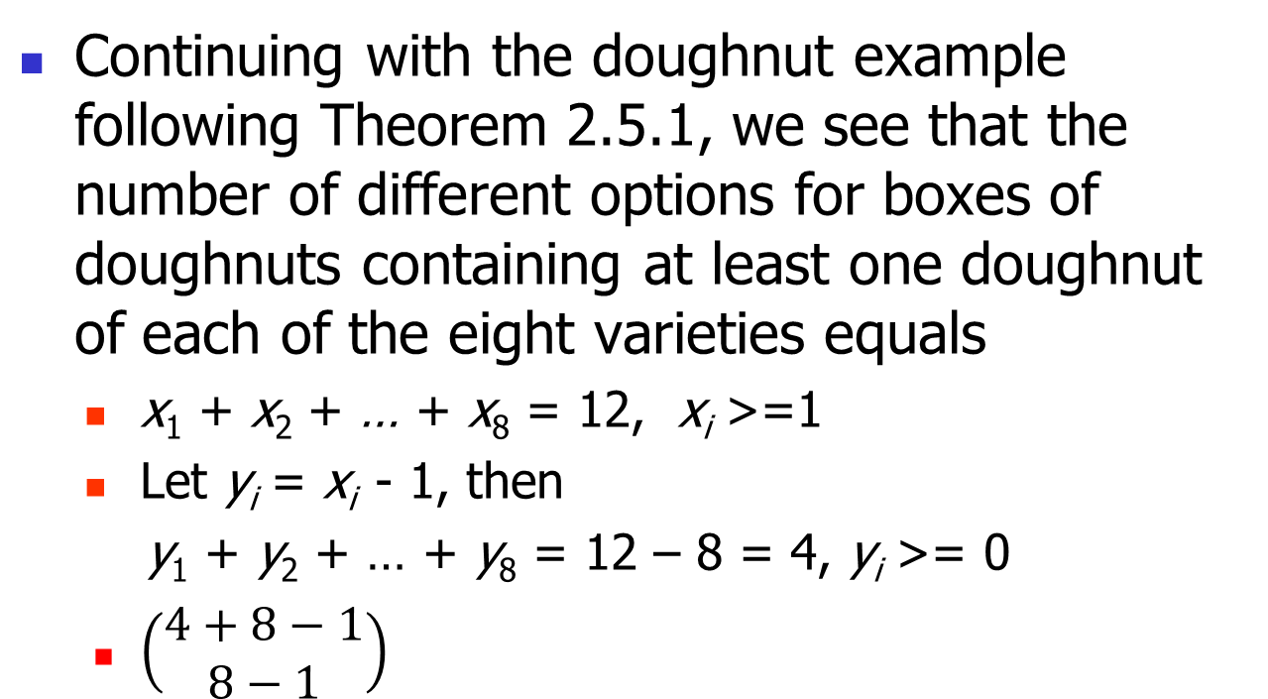
Example(self study)
Continuing with the doughnut example following Theorem 2.5.1, we see that the number of different options for boxes of doughnuts containing at least one doughnut of each of the eight varieties equals
x₁ + x₂ + … + x₈ = 12, x_{i} >=1
Let y_{i} = x_{i} - 1, then
y₁ + y₂ + … + y₈ = 12 – 8 = 4, y_{i} >= 0
$\left(\begin{matrix}4+8−1 \\ 8−1\end{matrix}\right)$

Slide 67
General Lower Bounds Problem
General lower bounds on the number of times each type of object occurs in the combination.
What is the number of integral solutions of the equation x₁ + x₂ + x₃ + x₄ = 20, in which x₁ >= 3, x₂ >= 1, x₃ >= 0, x₄ >= 5
Solution
y₁ + y₂ + y₃ + y₄ = 20 – 3 – 1 – 0 – 5 = 11.

Slide 68
All Submultisets of Multisets
For a subset S = {n₁·a₁, n₂·a₂, …, n_{k}·a_{k}}, what’s the number of all combinations (submultisets) of S with cardinality from 0 through |S|.
(n₁ + 1) * (n₂ + 1) * … * (n_{k} + 1).

Slide 69
Summary
Kinds of Combination of Multisets
r-combination of multisets with infinite (or plenty of) supply.
With or without lower bounds.
Number of all submultisets of a multiset with finite repetition number.

Slide 70
Summary of this Chapter
Four Basic Counting Principles
Permutations and combination of Sets
Circular Permutations
Two Kinds of Permutation of Multisets
r-permutation of multisets with infinite(or plenty of, in other words “>= r”) supply.
Full permutation of multisets with limited supply (in other words, with finite repetition number).
Combination of Multisets
Refer to the previous page.

Slide 71
2.6 Finite Probability (neglected for this course)

Slide 72
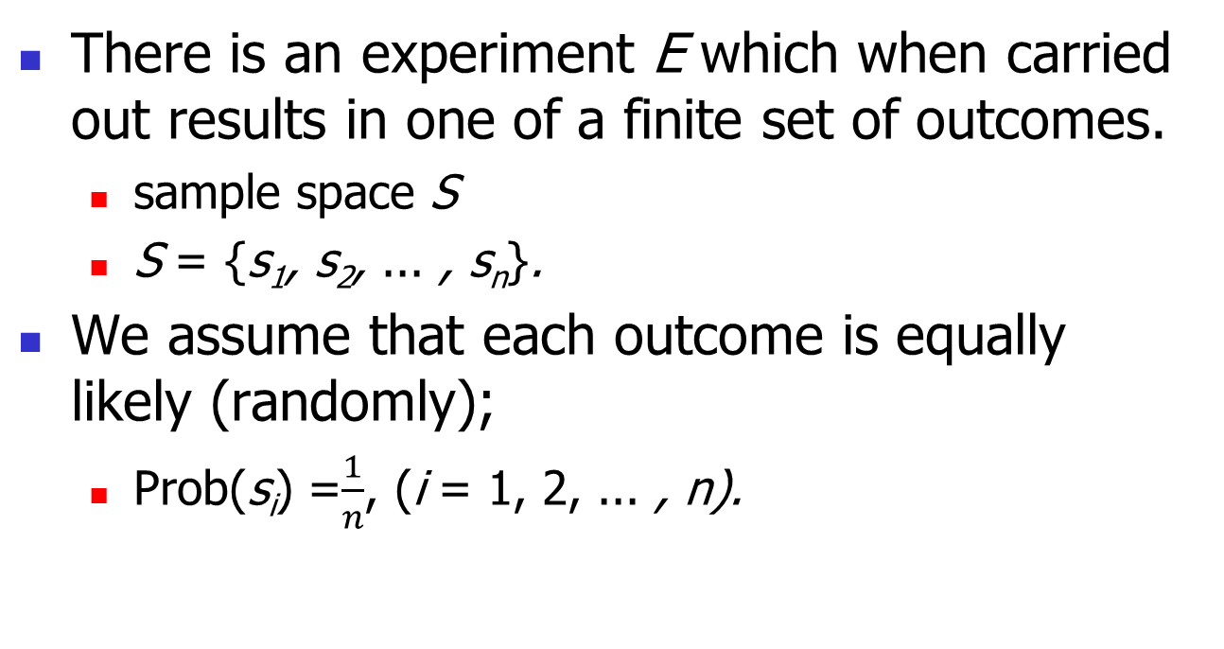
2.6 Finite Probability
There is an experiment E which when carried out results in one of a finite set of outcomes.
sample space S
S = {s₁, s₂, ... , s_{n}}.
We assume that each outcome is equally likely (randomly);
Prob(s_{i}) =$\frac{1}{n}$, (i = 1, 2, ... , n).

Slide 73
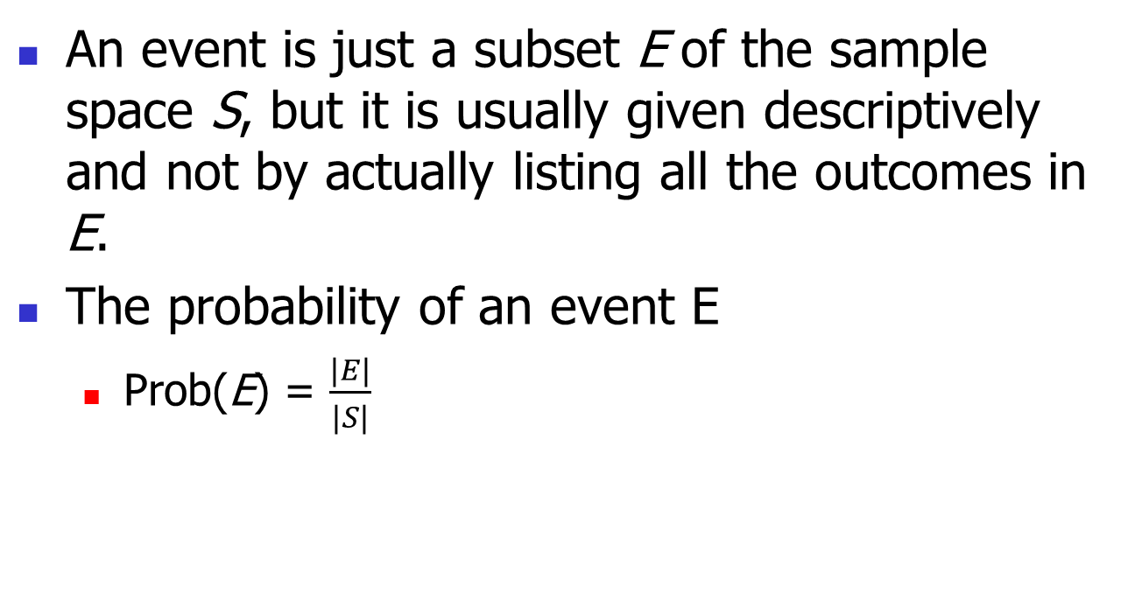
Finite Probability
An event is just a subset E of the sample space S, but it is usually given descriptively and not by actually listing all the outcomes in E.
The probability of an event E
Prob(E) = $\frac{|E|}{|S|}$

Slide 74
Example
Consider the experiment E of tossing three coins, where each of the coins lands showing either Heads (H ) or Tails (T ). the sample space is ?
2³

Slide 75
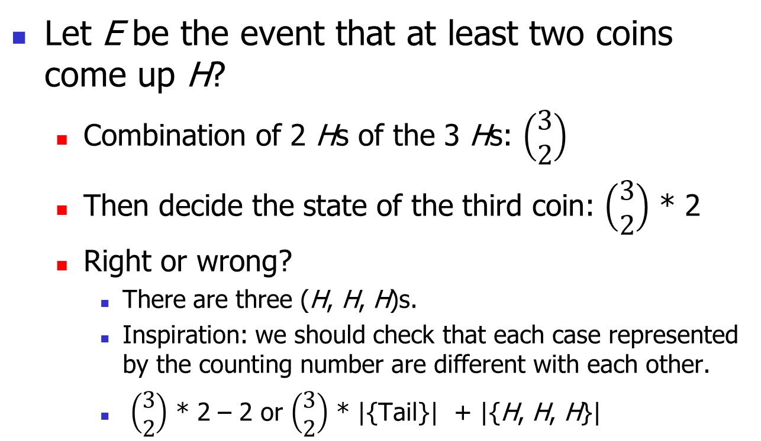
Example
Let E be the event that at least two coins come up H?
Combination of 2 Hs of the 3 Hs: $\left(\begin{matrix}3 \\ 2\end{matrix}\right)$
Then decide the state of the third coin: $\left(\begin{matrix}3 \\ 2\end{matrix}\right)$ * 2
Right or wrong?
There are three (H, H, H)s.
Inspiration: we should check that each case represented by the counting number are different with each other.
$\left(\begin{matrix}3 \\ 2\end{matrix}\right)$ * 2 – 2 or $\left(\begin{matrix}3 \\ 2\end{matrix}\right)$ * |{Tail}| + |{H, H, H}|

Slide 76
Example
Let n be a positive integer. Suppose we choose a sequence i₁, i₂, … ,i_{n} of integers between 1 and n at random.
(1) What is the probability that the chosen sequence is a permutation of 1, 2, ... ,n?
(2) What is the probability that the sequence contains exactly n - 1 different integers?

Slide 77
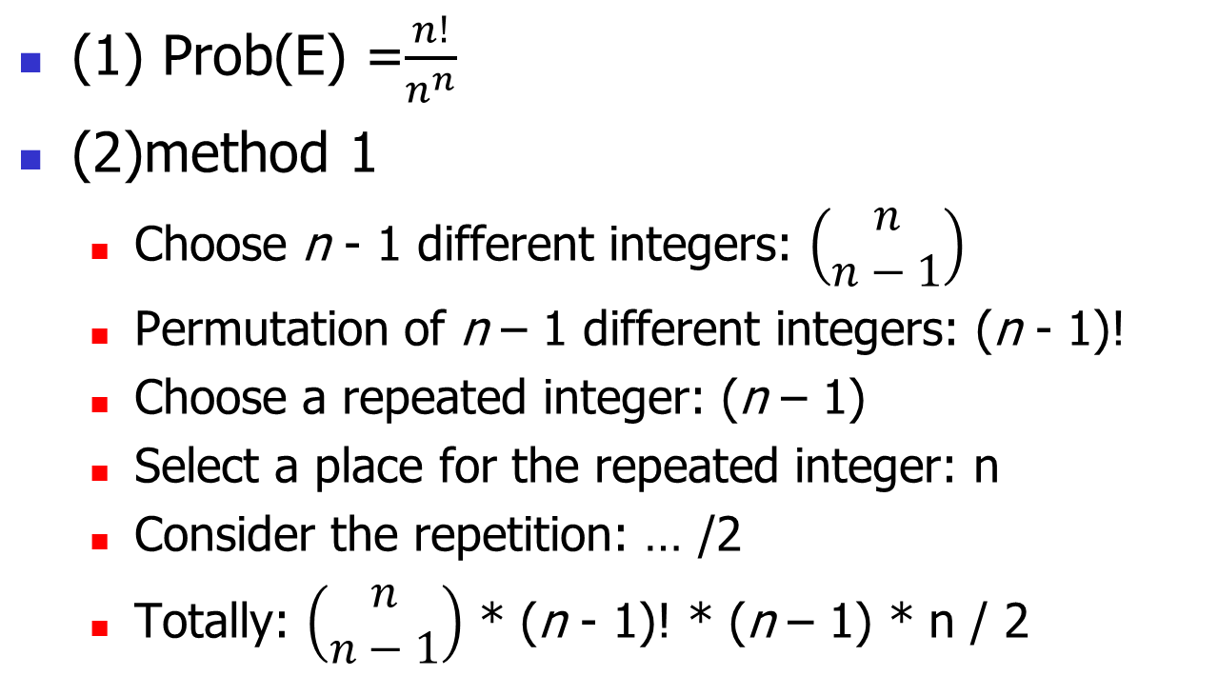
Example
(1) Prob(E) =$\frac{n!}{n^{n}}$
(2)method 1
Choose n - 1 different integers: $\left(\begin{matrix}n \\ n−1\end{matrix}\right)$
Permutation of n – 1 different integers: (n - 1)!
Choose a repeated integer: (n – 1)
Select a place for the repeated integer: n
Consider the repetition: … /2
Totally: $\left(\begin{matrix}n \\ n−1\end{matrix}\right)$ * (n - 1)! * (n – 1) * n / 2

Slide 78
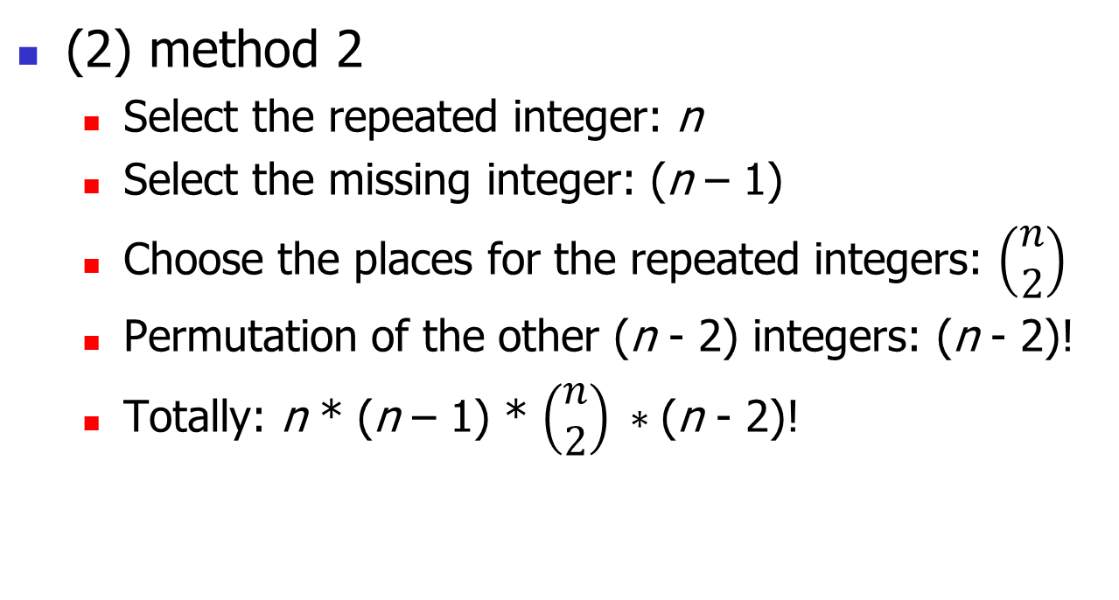
Example
(2) method 2
Select the repeated integer: n
Select the missing integer: (n – 1)
Choose the places for the repeated integers: $\left(\begin{matrix}n \\ 2\end{matrix}\right)$
Permutation of the other (n - 2) integers: (n - 2)!
Totally: n * (n – 1) * $\left(\begin{matrix}n \\ 2\end{matrix}\right) ∗\text{(}\text{n} \text{− 2)!}$

Slide 79
Example
Five identical rooks are placed at random in nonattacking positions on an 8-by-8 board. What is the probability that the rooks are both in rows 1, 2, 3, 4, 5 and in columns 4, 5, 6, 7, 8?

Slide 80
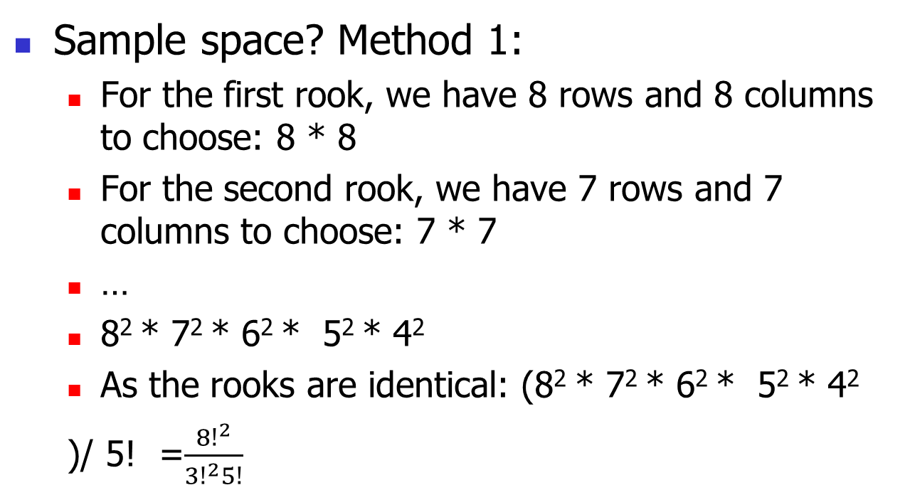
Example
Sample space? Method 1:
For the first rook, we have 8 rows and 8 columns to choose: 8 * 8
For the second rook, we have 7 rows and 7 columns to choose: 7 * 7
…
8² * 7² * 6² * 5² * 4²
As the rooks are identical: (8² * 7² * 6² * 5² * 4²
)/ 5! =$\frac{{8!}^{2}}{{3!}^{2}5!}$

Slide 81
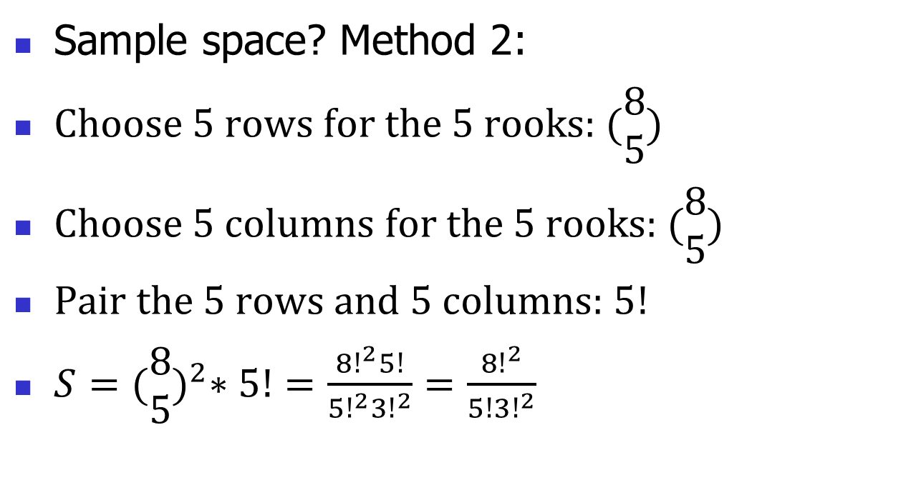
Example
Sample space? Method 2:
Choose 5 rows for the 5 rooks: $(\begin{matrix}8 \\ 5\end{matrix})$
Choose 5 columns for the 5 rooks: $(\begin{matrix}8 \\ 5\end{matrix})$
Pair the 5 rows and 5 columns: $5!$
$S={(\begin{matrix}8 \\ 5\end{matrix})}^{2}∗5!=\frac{{8!}^{2}5!}{{5!}^{2}{3!}^{2}}=\frac{{8!}^{2}}{5!{3!}^{2}}$

Slide 82

Example
Number of Events
5!
Probability:
$$p=\frac{E}{S}=…$$

Slide 83
Example(the card game Poker)
refer to the example on page 58(71/618) of the textbook
An ordinary deck of 52 cards
a full house: that is, three cards of one rank and two cards of a different rank (suit doesn't matter).
a straight: that is, five cards of consecutive ranks (suit doesn't matter).
the straights can begin with any of 1,2.... , 10. A can be both 1 or A.
a flush: five cards of the same suit.
a straight flush: that is, five cards of consecutive ranks, all of the same suit.

Slide 84
Example
exactly two pairs: that is, two cards of one rank, two cards of a different rank, and one card of an additionally different rank.

Slide 85
Exercises
Basic principles or basic permutation and combination: 2, 3, 4, 10, 12, 39, 58
Circular permutation: 7, 9, 20,
Permutation or combination of multisets: 13, 33, 38,

